Slide 1
K18X001.00 FT2 Station Test Fail Report
Prepare by: PE- Phuong
Date: Dec 06th 2021

Slide 2
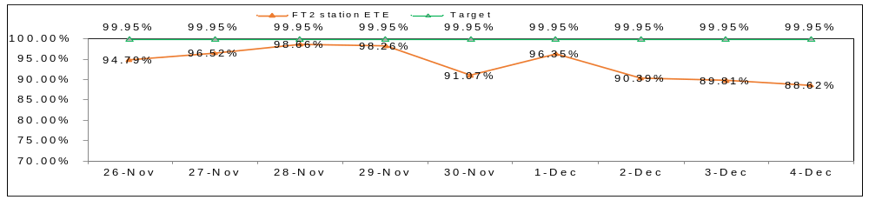
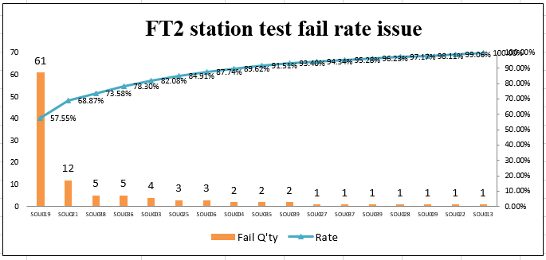
FT2 Station ETE Yield Rate
1. Background Information
- K18X001.00 MP production MO: 2639001984* 2K from 11/26/2021 to 12/05/2021.
At FT2 station test have ETE very low as below:
SOU019*5pcs
SOU019*4pcs
SOU019*7pcs
SOU019*6pcs
SOU019*6pcs
SOU019*9pcs
SOU019*11pcs
SOU019*6pcs
SOU019*7pcs
Top 1
FT2 station Woofer speaker left to right radio issue
Project | Total | Q'ty fail | Defect rate(%)
DVT1 | 40 | 0 | 0
DVT2 | 132 | 0 | 0
DVT3 | 185 | 0 | 0
DVT4 | 100 | 3 | 3.00
Pre_MP 1K MO: 2639001053/ 2639001509 | 971 | 16 | 1.65
MP_2K MO: 26390011826/ 2639001868/ 2639001581 | 1996 | 7 | 0.35
MP_2K MO: 2639001984 | 2000 | 61 | 3.05
Notes:
2
2

Slide 3
FT2 Station Issue History
1. K18X001.00 FT2 issue history
K18X001.00 FT2 Station Issue History
The builds | Q'ty production | FT2 Station Defect rate | FT2 issue | Remark
DVT1 | 40pcs | 17.50% | Check speaker failure 1. Check VI did not find out abnormal 2. Re-test 7pcs at FT2 station. 5pcs PASS, 2pcs still speaker check fail 3. Test 3 times 2pcs fail then have fail value is different 4. Shipping 2pcs NG speaker to RD further analysis. 02/08 => Suggest ATBU device issue | 1. Ship 2pcs fail speaker at FT2 station for RD analysis. 02/08 2. Co_work with ATBU vendor to verify environment 3. Need RD team update the root cause and action to improve this issue
DVT2 | 132pcs | 6.06% | Check THD speaker failure 1. Check VI did not find out abnormal 2. Both Left and Right speaker also failed THD test item , the fail value focus on upper limited spec which were around 8 ~ 10 dB 3.Swapping left treble speaker , this issue follows treble speaker but value also margin upper limited spec => Suggest spec or environment issue need RD confirm this issue | 1. PE/TE keep monitoring this is issue 2. Co_work with ATBU vendor change spec 03/01. done 3. After change spec then FT2 test fail 8/132pcs 4. Need RD team and ATBU vendor update root cause and action to improve check THD speaker fail issue Solution in next build 1. Send NG speaker ( PN: 352.00190.005LT) to DREAMUS vendor to furhter analysis. Owner: PE: Louis/ QA: Ken 2. Record the video of the operation send to RD for improve. Owner: PE: Louis, RD: Henry. Due date: Next build
DVT3 | 185pcs | 0%
DVT4 | 100pcs | 6% | SOU021: Woofer Speaker_Left to Right Radio check fail *3pcs~3% 1. Check VI find out housing assembly not well => Assembly sticking plaster gasket not well*3pcs - The value different of two speaker left and right: Woofer Speaker_Balance_Left - 1k Hz = 1.720914 db(0.1, 20) PASS Woofer Speaker_Balance_Right - 1k Hz = 3.261951 db(0.1, 20) PASS Woofer Speaker_Left to Right Radio = 0.527572 %(0.7, 1.4) Fail 2. Check VI find out housing assembly not well => Assembly sticking plaster gasket not well*3pcs | - Training OP stick gasket on case top follow SOP - Need TE and soundbar test vendor improve spec issue
Pre_MP_1K | 971pcs | 1.43% | SOU021: Woofer Speaker_Left to Right Radio check fail *16pcs~1.43% - Balance left = 2.889682 db , spec (0.1,20) - Balance right = 6.240623 db, spec (0.1,20) - Left to Right Radio = Balance_Left / Balance_Right= 2.889682 / 6.240623 = 0.463044 % | Short term: -Training OP assembly top case follow SOP - Replace speakers with nearly the same value spec. Long term: - Need TE and sound bar test vendor improve spec issue
MP_2K | 1996pcs | 4.92% | 1. SOU007: Full Range Speaker_Frequency Response - 8k Hz check fail *20pcs~1.0% 2. SOU021: Woofer Speaker_Air Leakage Test_Pushing - 550 Hz check fail *15pcs~ 0.75% 3. SOU023: Woofer Speaker_Air Leakage Test_Pushing - 550 Hz check fail * 10pcs~0.5% 4 SOU019: Woofer speaker left to right radio check fail *7pcs~0.35% | 1. TE_CFT change FT2 test program: change item: Woofer Speaker_Air Leakage Test_Pushing - 550 Hz check fail * 0.75% from SOU023 to SOU021. 11082021 2. Change spec for Full Range Speaker_Frequency Response - 8k Hz from (65, 95) to (54, 90)
MP: 2K | 2000pcs | 3.1% | 1: SOU019: Woofer Speaker_Left to Right Radio check fail *61pcs~3.1% 2. SOU021 : Woofer Speaker_Air Leakage Test_Pushing - 550 Hz check fail *12pcs~ 0.6% | Short term: -Training OP assembly top case follow SOP - Replace speakers with nearly the same value spec. Long term: - Need TE/ RD and sound bar test vendor improve spec issue
Notes:
3
3

Slide 4
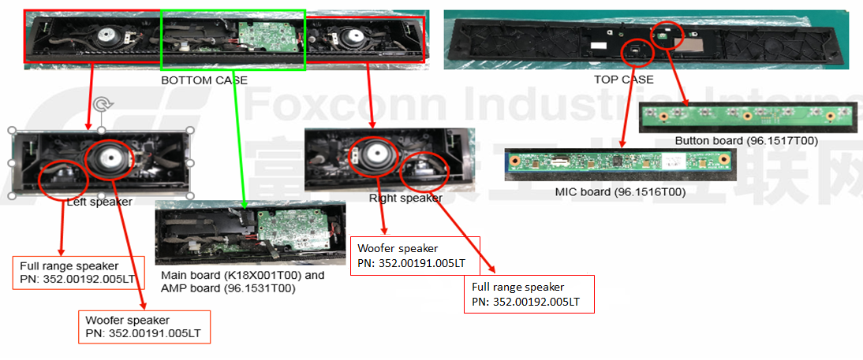
Visual Inspection
1. Visual inspection
- Check visual inspection for NG boards at FT2 station as below :
Summary:
- Didn’t not find out abnormal.

Slide 5
TOP1: Woofer Speaker_Left to Right Radio check fail-1
1. Background and fail symptom:
- At this build MP_2K FT2 station test find out error: SOU0019: Woofer Speaker_Left to Right Radio check fail out of spec (0.7, 1.4) with defect rate 61/2000=3.1%
2. FA status:
- Step 1: Check VI and assembly no find out abnormal.
- Step 2: Retest NG board ➔ Still fail with value out of spec(0.7, 1.4)
- Step 3: Because: Left to Right Radio value = Balance_Left _1K Hz value / Balance_Right_1K Hz value is out of spec(0.7, 1.4)
Change new woofer speaker (PN: 352.00191.005LT) of NG sample ( left or right woofer speaker) . and then retest at FT2 station result:
K18X001.00 Change New Woofer speaker Verification
Items | Before change Woofer speaker |  |  | After change new Woofer speakers
 | Woofer Speaker_Left to Right Radio (0.7 1.4)% | Woofer speaker balance left, spec: (0.1 20) DB | Woofer speaker balance right, Spec: (0.1 20)DB | Woofer speaker balance left(0.1 20)DB | Woofer speaker balance right(0.1 20)DB | Woofer Speaker_Left to Right Radio (0.7 1.4)% | Result | Remark
NG sample | 1.514528 | 5.078873 | 3.353436 | 2.921964 | 3.353436 | 0.871334 | Pass | Change new Woofer left
 |  |  |  | 5.078873 | 5.088233 | 0.998160 | Pass | Change new Woofer right
 |  |  |  | 6.701647 | 5.563843 | 1.204499 | Pass | Change 2 new Woofer speakers

Slide 6
TOP1: Woofer Speaker_Left to Right Radio check fail-2
- Step 4: Swap 2 Woofer speakers of NG product (PN: 352.00191.005LT) with OK product such as test result:
Summary:
- This issue follow 2 values balance of Woofer speaker balance left and balance right at 1K Hz.
- Change new 1 woofer speaker left or right with value not too much difference to solve this issue
K18X001.00 Swap 2 Woofer Speakers Verification
Items | Woofer speaker balance left(0.1 20) DB | Woofer speaker balance right (0.1 20)DB | Woofer Speaker_Left to Right Radio (0.7 1.4)% | Result
2 NG Woofer speakers + NG Board | 1.301458 | 3.605083 | 0.361006 | Fail
2 OK Woofer speakers + NG Board | 5.886064 | 5.088233 | 1.156799 | Pass
2 NG Woofer speakers + OK Board | 1.301458 | 3.605083 | 0.361006 | Fail
2 OK Woofer speakers + OK Board | 5.886064 | 5.088233 | 1.156799 | Pass

Slide 7
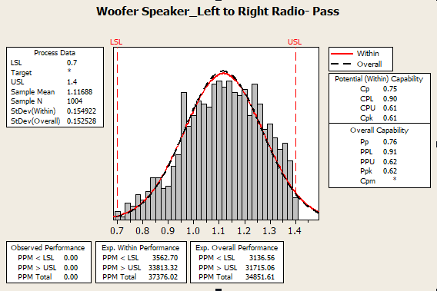
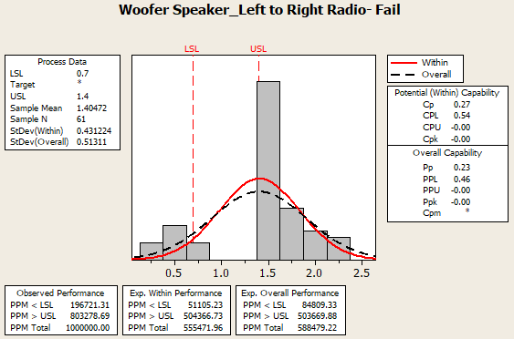
TOP1: Woofer Speaker_Left to Right Radio check fail-3
CPK analysis
Woofer speaker_left Left to Right Radio CPK report:
- Check CPK of 61pcs fail and CPK pass of Woofer Speaker_Left to Right Radio
Summary:
- For Pass CPK data, CPK = 0.61_level D. CPK chart is unfocused
- For Fail CPK data , CPK = 0.00 . Fail lower than spec value from 0.28 to 0.67 (19.67%), and Fail higher than spec value from 1.407 to 2.50 (80.32%)

Slide 8
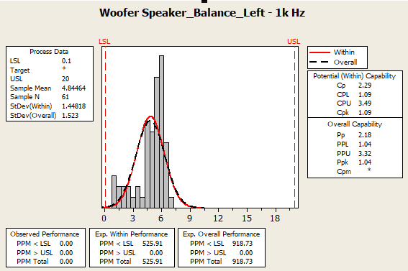
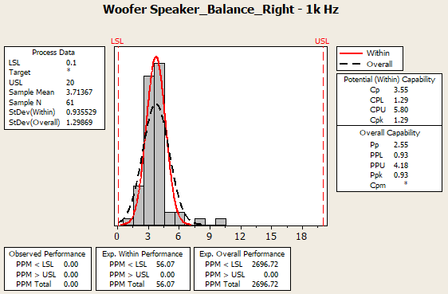
TOP1: Woofer Speaker_Left to Right Radio check fail-4
Because Left to Right Radio = Balance_Left _1K Hz/ Balance_Right_1K Hz:
- Check CPK of Woofer speaker balance_Left _1K Hz and woofer speaker balance_Right_1K Hz of 61pcs fail
- Woofer speaker balance left at 1K Hz value from 0.9 to 6.9 db spec ( 0.1 , 20) ➔ PASS
- Woofer speaker balance right at 1K Hz value from 1.1 to 9.9 db spec ( 0.1 , 20) ➔ PASS
➔ With this value then Left to Right Radio value from 0.07% to 6.36 %
Summary:
This issue follow value balance of woofer speaker left and right value at 1K Hz is not the same
To solve this issue suggest change Woofer Speaker_Left to Right Radio spec from (0.7, 1.4) to (0.5 , 2.5)

Slide 9
Conclusion
1. Preliminary conclusion
As analyzed above this issue follow value balance of Woofer speaker balance left_1K Hz and Woofer speaker balance right_1K Hz is not the same
2. Action
Short term
Change new 1 woofer speaker left or right with value not too much difference to solve this issue
➔ This issue has very high defect rate: 3.1%, so that in the process of opening housing, change new speaker will affect the quality of production( output, human resources and product quality).
Owner: PD: Van Anh, PE: Phuong
Long term
Suggest change spec from (0.7 1.4)% to (0.5 2.5)% to improve this issue
Owner: RD: Tom, Sean, TE: Allan, PE: Phuong

Slide 10
THANKS

